Slide 1
Thermal Equilibrium

Slide 2
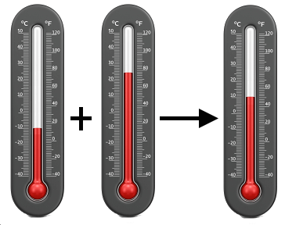
In this Smart Lesson you will learn to:
Define thermal equilibrium in terms of the temperature and average kinetic energy of the particles in each of the systems.
Explain the process in which thermal energy is transferred between two systems until thermal equilibrium is achieved and recognise this as the zeroth law of thermodynamics.
Solve problems involving specific heat capacity, specific latent heat and thermal equilibrium.

Slide 3

Thermal equilibrium.
Thermal equilibrium is defined as the condition of a system in which there is no net exchange of thermal energy between any of its components, i.e. the components have the same temperature and the average kinetic energy of their particles is equal; this relates to the zeroth law of thermodynamics.

Slide 4
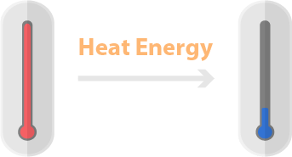
The zeroth law of thermodynamics.
Thermodynamics is a branch of physics that deals with relationships between heat and other forms of energy.
The zeroth law of thermodynamics states that there will be the transfer of energy from a system with higher temperature to a system with lower temperature until thermal equilibrium is reached.
In simple terms, heat moves from a hotter object to a cooler one until they reach the same temperature!

Slide 5
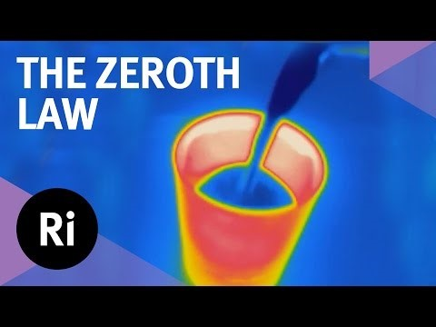

Slide 6
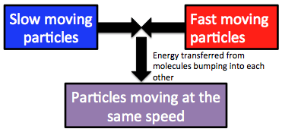
When two substances with different temperatures are brought into contact, heat transfer will occur.
One substance will lose heat and the other substance will gain the same amount of heat until the two substances are the same temperature.
There are still collisions between particles of the two substances which have reached thermal equilibrium. However, there is no net energy transfer, so the temperatures of the substances do not change.

Slide 7
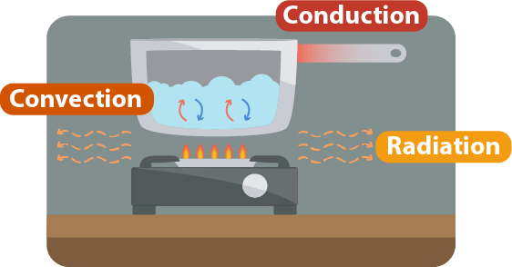
Heat transfer.
Heat can be transferred from one place to another by conduction, convection or radiation.
Net heat transfer always occurs in the direction of the hotter system to the cooler system.

Slide 8
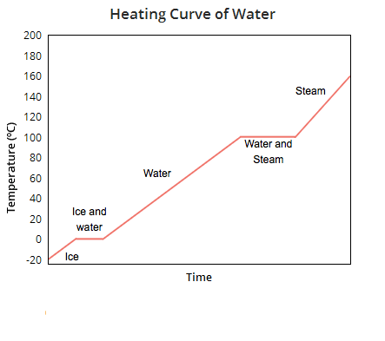
Temperature change does not occur during a phase change.
This is because the heat being added to the substance increases the potential energy of the substance, not the kinetic energy.
This graph shows the temperature of water as heat is added to it at a constant rate.
As you can see, there is a constant increase in temperature when there is no phase change but no change in temperature when there is a phase change.

Slide 9
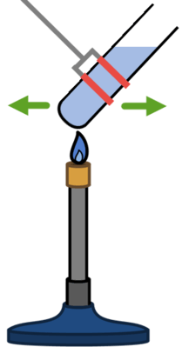
Calorimetry calculations.
You should already be familiar with calculations involving specific heat capacity.
Q=mcΔT
The energy (Q) equals mass (kg) × specific heat capacity × change in temperature.

Slide 10
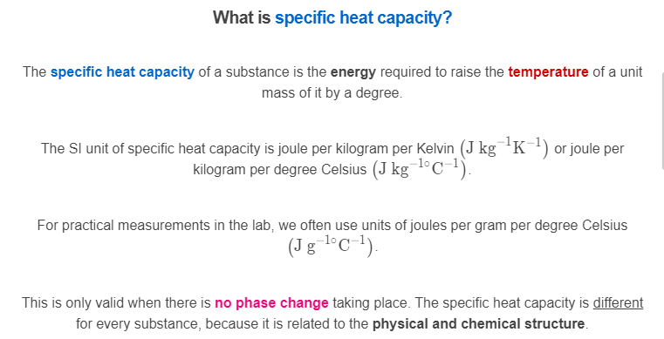

Slide 11
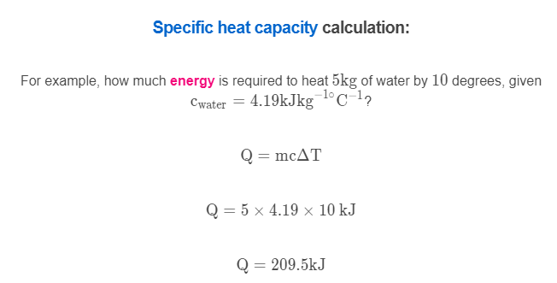
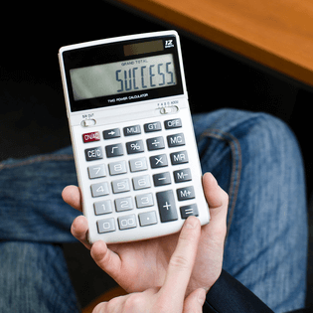

Slide 12
Specific Latent Heat.
The specific latent heat of fusion is the energy required to convert 1kg of solid to liquid.
For example, the specific latent heat of fusion (L_{f​}) of ice is around 333 kJkg⁻¹.
How much energy would it take to melt 200 g of ice?
First change the mass to the correct units: 200 g=0.2 kg.
Q=m×L_{f}​
Q=0.2×333 kJ
Q=66.6 kJ

Slide 13
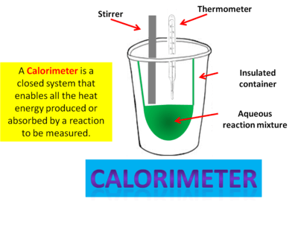
You will be expected to solve problems using specific heat capacity, specific latent heat and thermal equilibrium.
These problems will involve mixing a warmer substance with a colder substance.
Assuming the law of conservation of energy, the energy lost by the warmer system must equal the energy gained by the cooler system, assuming no losses to the environment.
You may do some experiments using calorimeters to try and minimise environmental losses and test these calculations.

Slide 14
Calorimetry calculation example:
How much ice at −10.0∘C must be added to 4.00 kg of water at 20.0∘C to cause the resulting mixture to reach thermal equilibrium at 5.0∘C? Assume no energy transfer to the surrounding environment, so that energy transfer occurs only between the water and ice.
Specific heat capacity of water (c)=4.19 kJkg^{−1∘}C⁻¹
Law of conservation of energy leads to the energy gained by the ice must equal the energy lost by the water.
Energy lost by the water cooling(Q_{water}​) =mcΔT
ΔT=20−5
Q_{water}​=4.00×4.19×15
Q_{water}​=251.4 kJ

